Slide 1
Meeting 2016/08/25 – Telang analysis – Executive summary
Telang method mostly allows to detect high counts prominent regular patterns of the city
DoW / Nightlife / busy districts → good tool to understand patterns
Due to non-use of a baseline
Different gini thresholds allows to detect either broad tendencies or localized pattern
Usually short time span
Method favors big anomalies but balanced by homogeneity constraint
The use of clustering allows to detect irregular anomalies
Along roads / busy region with a hole
Results are mostly stable for different grid resolutions

Slide 2
Meeting 2016/08/25 – Telang analysis
Problematic
Preprocessing
Indicators analysis
Visual Analysis

Slide 3
1 – General problematic
What is this technique’s use? Technique as a whole
Map technique → application
No ‘good’ or ‘bad’
Create a recipe / understand the influence of every brick-ingredient
NATURE of the events detected
Various techniques & parameters → Event exploration
Compatibility with urban data?
➔ Framework
Most basic problem
Most common parameters

Slide 4
1 - Problematic
What types of events are detected / missed by telang’s method?
Additive bias? Flaws?
Range of events with various parameters → different purposes? Tendencies vs local pattern? Gini, Padvalue
Influence of =/= bricks: homogeneity threshold, clustering, statistical test score
What are the typical / average morphologies of anomalous clusters?
Size, temporal extent, shape, high/low counts
Map anomaly to data counts
Implementation issues
Processing required? Grid resolution
Easy parameter design?
Adaptation to urban data & road network
NYC Exploration
Frequent patterns: Belts, rush hours, nightlife, early activity
Exceptional events?
Computation?
How does it compare to previous SaTScan experiments? To be continued
How can we change the use of the method?

Slide 5
1 – Why Telang?
Clustering
Close to basic ST-DBSCAN
Region (Contextual) OD
‘Ready to implement’ method → includes anomalousness score
Basic problem
Grid data
Persistent events

Slide 6
Global reflection – Problem criteria overview
STOD
Time management: Temporal neighborhood
Event nature: Persistent homogeneous values
Outlier category: Clustering & Statistical
Unsupervised
Input Data: grid TS
Anomaly extension
Space extension: region
Time extension: interval
Global vs context
Time & Space context extension
Baseline: NONE
Application / Application specific: used for weather initially, but general
Offline
Scoring
Data preprocessing
Complexity

Slide 7
2. Preprocessing
Area: up to top Central Park
Only cells with 4 corners in Manhattan
Otherwise, detect sea border cells as anomalously low counts – counts are much lower than in-Manhattan cells
The Central Park question
Time
Oct 2011
1h precision (15min too expensive)
Smoothing
Density function: ellipse proportional to grid res / 50 for 70 for good homogeneity
Orientation N/S → No matter because 3x3 neighborhood around cell
Grid resolutions
100m → 500m
Computing: 50m & 70m

Slide 8
3. Indicators analysis
Table with avg values
95% + High counts anomalies
Big counts → +++ test score
Space size in n_cells
Increases with finer grid resolution for fixed gini
Spatial extension shrinks → restricted to center
Large gini → big regions / tendencies
Time span
For fixed gini, quite stable with finer grid resolution (except 500m resolution)
For fixed grid resolution, increases with gini
Test score
Gets higher with low grid resolution and
Average overall cluster size
Misleading on size of clusters → anomalies are often among the bigger homogeneous clusters
Plot graphs with gini variations / multiple curves for multiple grid res
Table

Slide 9
3. Indicators analysis

Slide 10
4. Visual analysis
Plot graphs with gini variations / multiple curves for multiple grid res
Global picture & parameters
Stability with various grid resolutions
Influence of gini parameter
Overall picture
Big gini → almost global temporal analysis. Large areas → most neighborhood = temporal neighbors of region
Small gini → localized anomaly / pattern identified
Good gini?
Discontinuity: 190 case
Exception of low counts → check next time
Cluster shapes: irregularity fit roads & region patterns / Regular shapes with big ginis
Top events nature
Exclusively regular patterns-trends / No exceptional events
Maybe because high counts favor patterns (exceptional events are blockages/accidents?)
Resolution?
Exceptional events are more subtle
NYC exploration: Frequent ST zones
Plot every “Zone”
Count number of occurences in some top40
Check low counts
Check more ano → top 100?

Slide 11
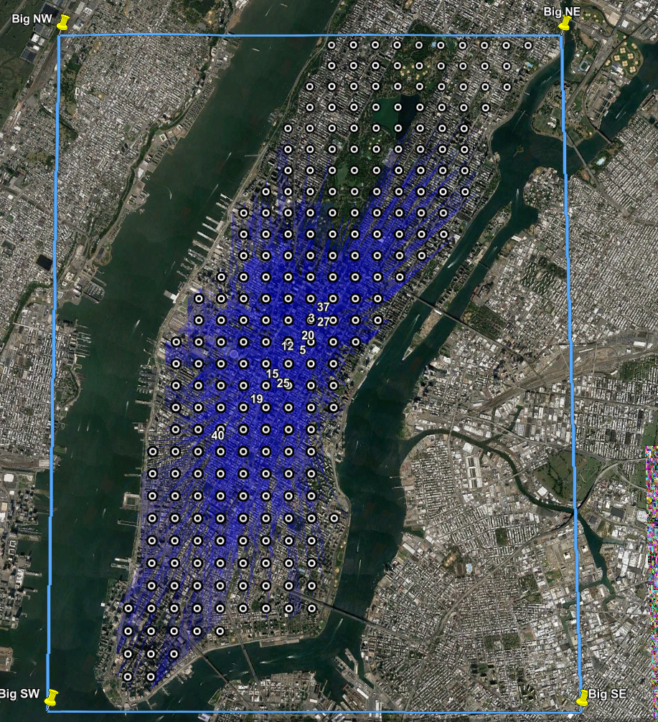
4.1. Overview
Parameters
Neighborhood → 2 S/T cells fixed
Gini: 0,01 – 0,03 – 0,1 – 0,3
Telang: 0,01, but more homogeneous values
Resolutions
500 – 360 – 250 – 190 – 140 – 100 – 70 – 50m
Clusters outputted: Top 40

Slide 12
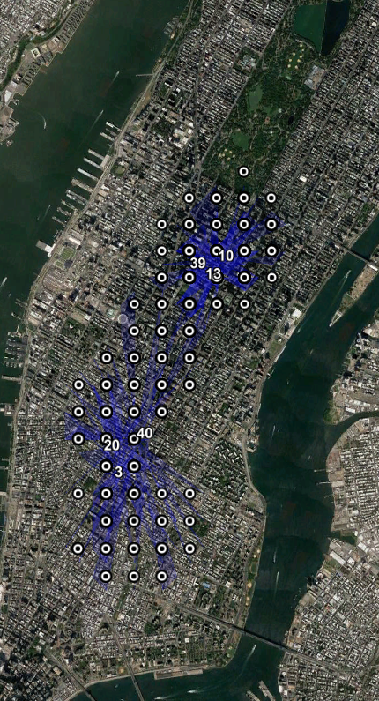
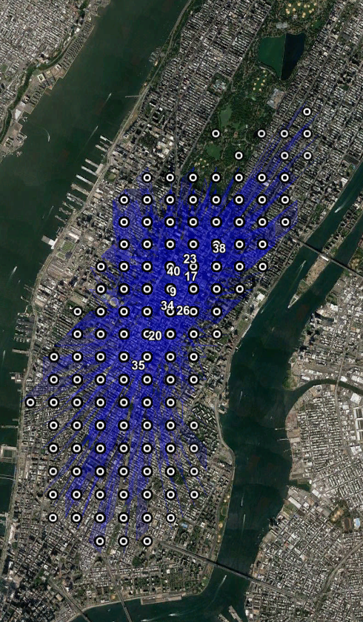
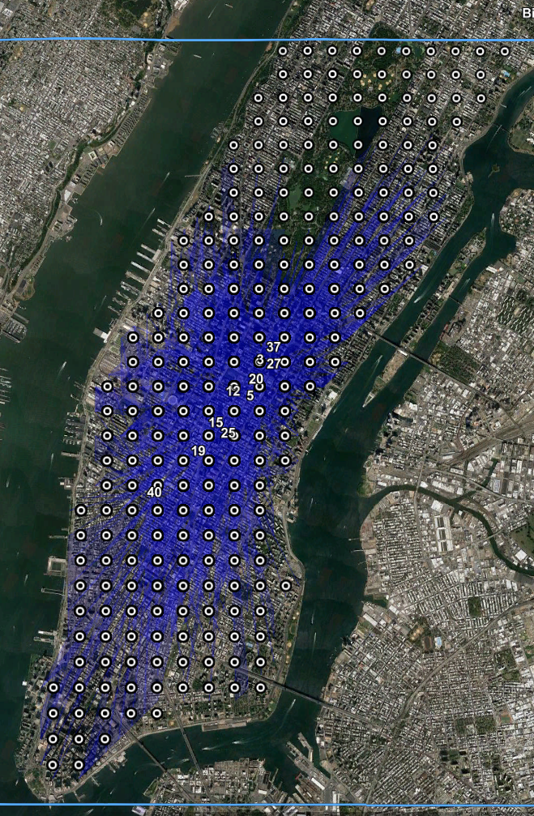
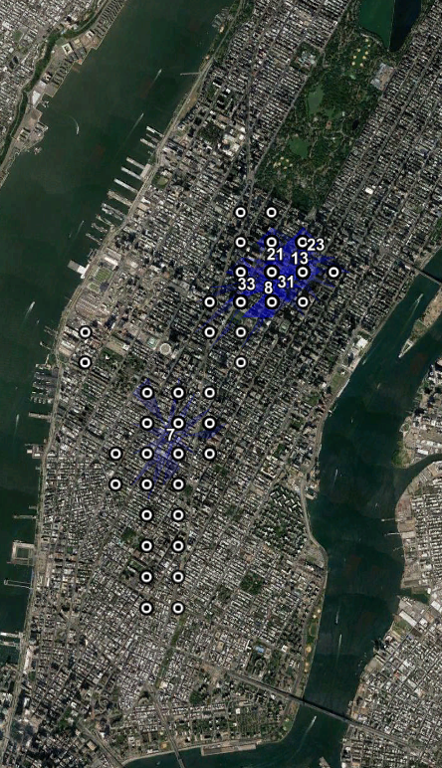
4.2. Results are mostly stable with grid resolution
i.) Same cover of the city over ginis & ii.) Recurrent events
All anomalies juxtaposed, 360m

Slide 13
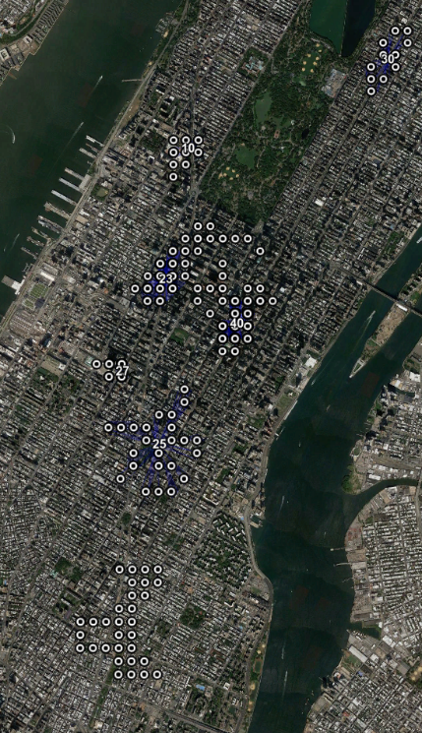
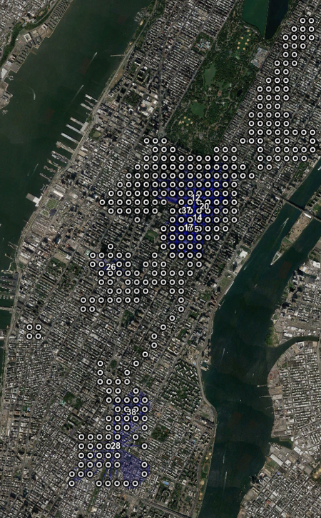
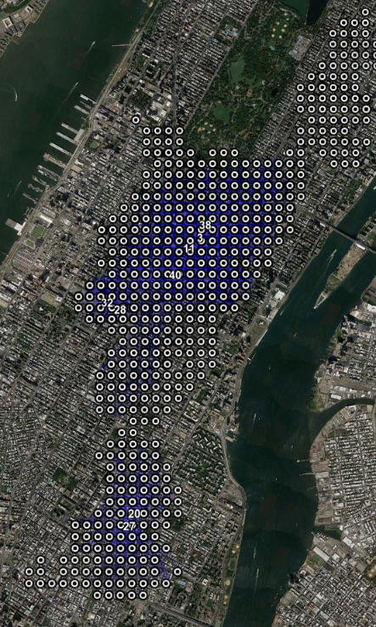
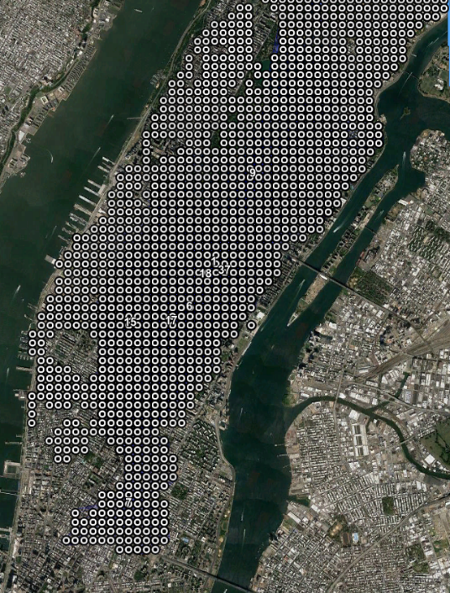
4.2. Results are mostly stable with grid resolution
i.) Same cover of the city over ginis & ii.) Recurrent events
g = 0,01
g = 0,03
g = 0,1
g = 0,3
FIG 6 All anomalies juxtaposed, 140m

Slide 14
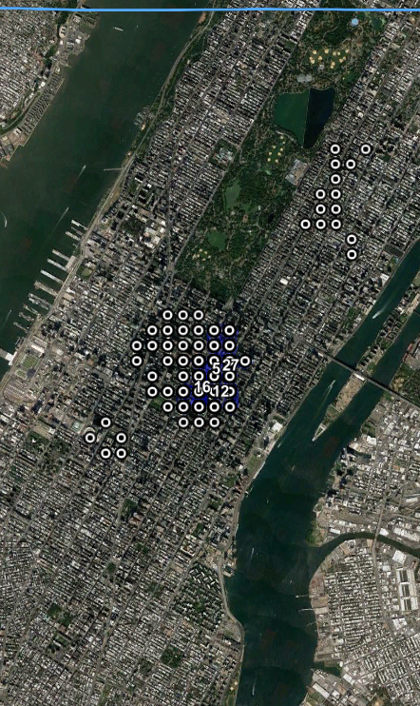
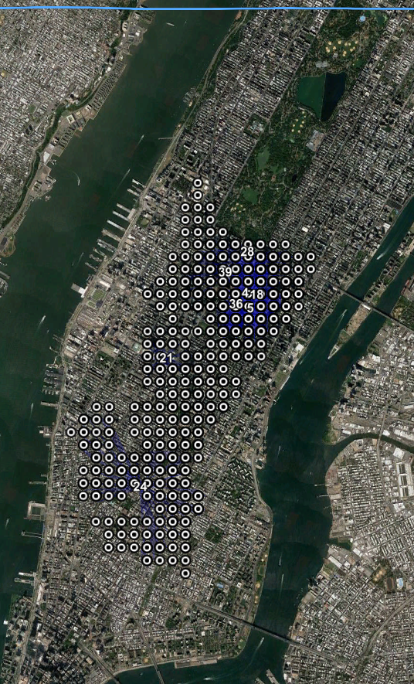
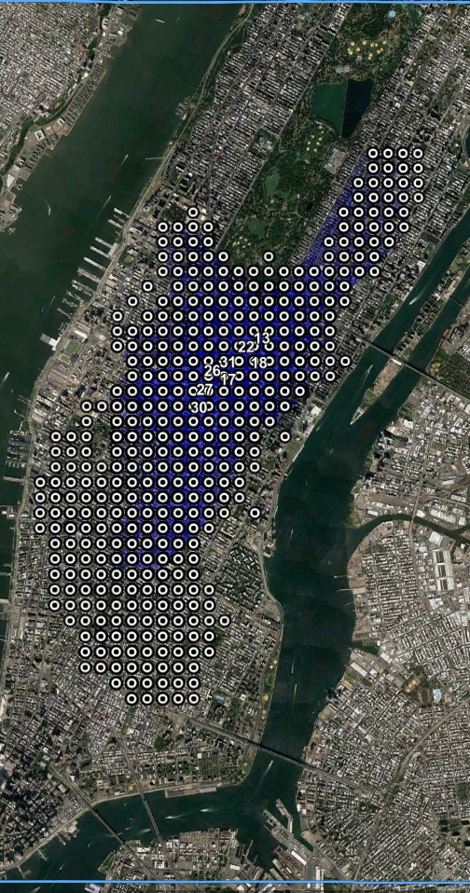
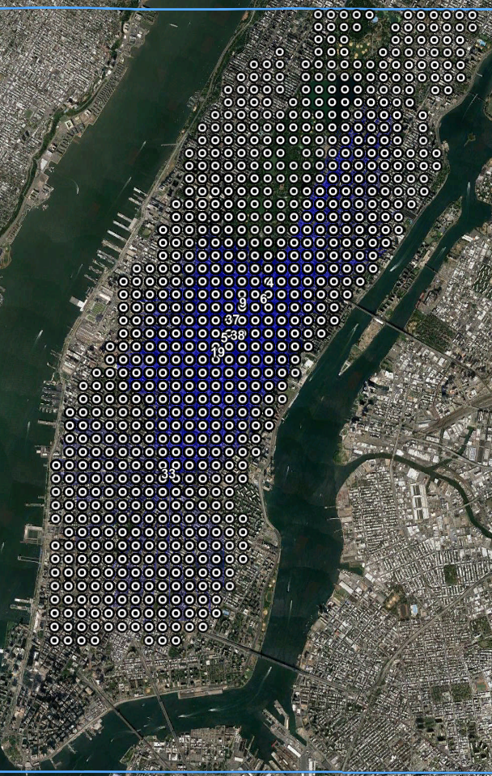
4.2. Results are mostly stable with grid resolution
Small trouble to grid stability: 190m grid
g = 0,01
g = 0,03
g = 0,1
g = 0,3
All anomalies juxtaposed, 190m
Village / Lower Manhattan appears only for 0,03
Exception among all grid resolutions

Slide 15
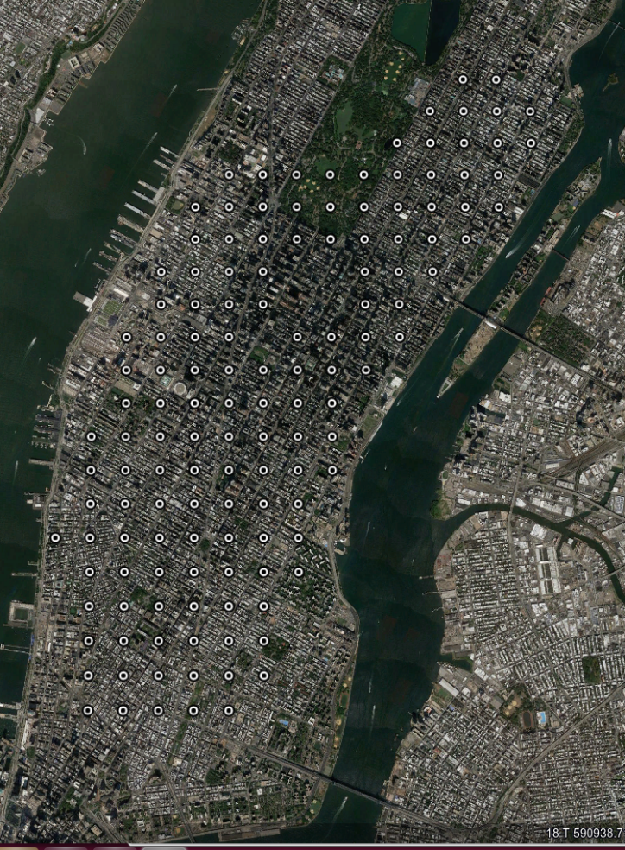
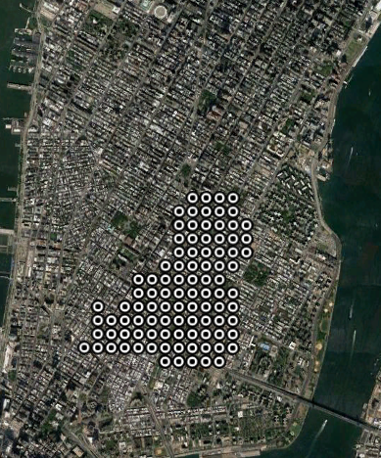
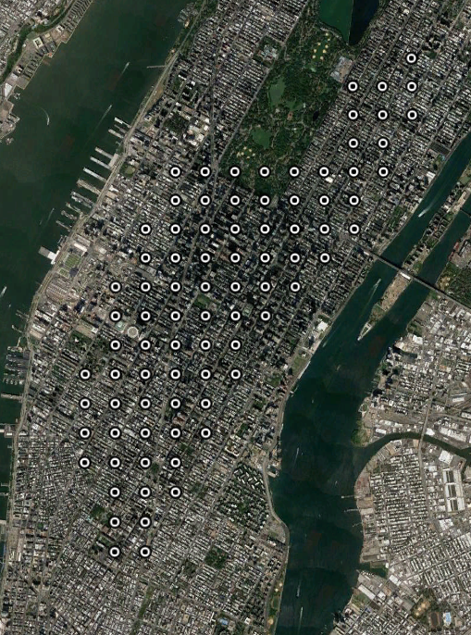
,3,
4.3. Varying ginis allows exploration of a range of events
Big ginis / Low resolution → global tendencies
r=360m / g =0,3
#6, 14-19h week day 19 → Back home
Mainly temporal analysis since most neighbors are merely temporal
r=360m / g =0,3
r=360m / g =0,3
#1, 6-11h week day
→ Morning activity
#7, 9-22h week day
→ EV/LES Nightlife

Slide 16
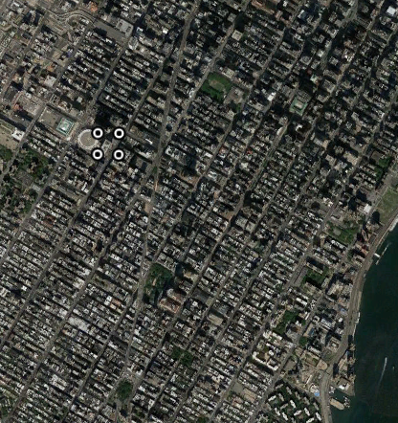
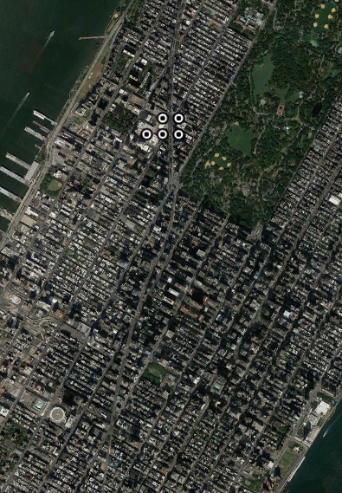
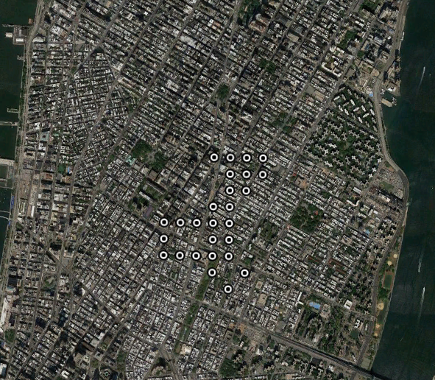
,3,
4.3. Varying ginis allows exploration of a range of events
Small ginis → localized pattern
r=140m / g =0,01
r=140m / g =0,01
#24, 3h week day
→ Penn st night train arrivals
#18, 17h late aft. week-end
Stanton/ Ludlow – 2nd Av – St Marks
Heart of outgoing NY
r=140m / g =0,01
#10, 18h week day 5 → High broadway traffic backhome
More versatile: fine resolution and ~ 0,03g

Slide 17
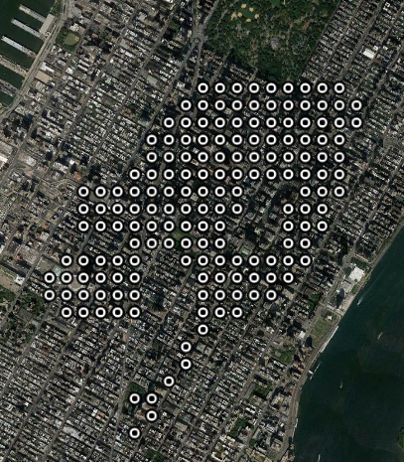
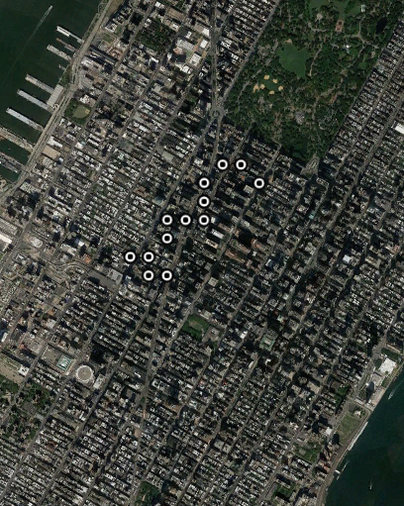
4.4. Cluster shapes: Irr/Regular depending on gini
i.) Low resolution & Big gini → homogeneous clusters, rather convex
r=140m, g=0,01
ii.) Fine resolution & low gini → Belts / lines to fit road network
Fits Broadway back home
r = 140m g = 0,3
iii.) Fine resolution & big gini → region with holes

Slide 18
4.5. NYC pattern exploration
Many patterns appear several times in the top40 anomalies at different ginis/resolution
Early Midtown activity → ??
Week-days ~ North Grand Central / 3h-4h-5h-6h
Often 40% of top 40, 50%+ top 10
Night Penn St: ~ 3h
Nightlife East Village / Lower East Side: Week-ends 19h-22h
Rush hours back to work: Midtown / Broadway NW – week days ~17h-18h
Week-end afternoons in Midtown: ~15h
Most anomalies are interpretable with traffic common sense: D-o-W / rush hours
Big question: Early/Night Midtown

Slide 19
5. Use of the technique: most prominent regular patterns
Top anomalies are regular events which stand out compared to their 2-range ST neighbors
CONTEXTUAL technique / baseline ~ mean of immediate ST neighbors
Homogeneity → easier interpretation
Good tool to detect most prominent city patterns
Casual anomalies are too subtle to be detected
Bias towards high counts anomalies → generate high test scores → low counts anomalies //road block not detected. Score =
(mean_ano)^counts_ano * (mean_neighbors)*counts_neighbors / (mean_ano&neig)^counts_ano&neigh
High when cluster mean =/= neighbors & high counts
Regular patterns strong → overshadow
Typical ranking: pattern1_t_i1 / pattern1_ti2 / pattern1_ti3 / pattern2_tj1 / pattern1_ti4 / pattern2_tj2…
TBC: check finer resolutions

Slide 20
Computation
Complexity
O( n_cells * n_time * p^2*log(p) ) where p mean cluster size
Computing time
140m-0,01g: 9000s
140-0,3g: 20000s
360m-0,01g:66s
360m-0,3g:170s

Slide 21
Comparison with SaTScan Space Time permutation
Remark: most popular version of SaTScan implements same test scoring, but with global ST neighborhood. This SaTScan version is not available for our data
BASELINE
SaTScan baseline is global → detects when a count is different from what it is all over the month ‘Anomalies’
Telang: Poisson distribution =/= SatScan: locations must behave always the same (check DoW adjustement)
Nature of events
No homogeneity constraint with SaTScan → ‘Double event check’ with Telang i.) homogeneous values ii.) neighbors comparison
Timespan is shorter for Telang because homogeneity constraint & counts very different at different hours of the day
Shape
SaTScan only ellipses / Telang better fits irregular regions
Computing
If strong constraint on cluster size, SaTScan may be faster
General SaTScan is much slower

Slide 22
Open questions / Possible improvements
Very strong night midtown trend 3h-4h North Grand central ??
Central Park bias?
Would increase North midtown / UES / UWS scores?
Study events counts → what rang the alarm?
Make an anomaly detection tool → incorporate regular patterns to baseline
Process counts
Mean of history counts
TS analysis…
Change neighborhood definition
Different Space / Time neighborhood
None-adjacent neighbors: same hour on different days / on same DoW in different weeks…
Keep homogeneity regularization in mind
May prove more relevant than size regularization to compute anomalous regions

